Slide 1


Connect securely with Azure SQL Database

Slide 2
Agenda
About the speaker
The Why
Azure SQL Foundations
Network layer
Logins & Users
Authentication Options
Wrap-up

Slide 3

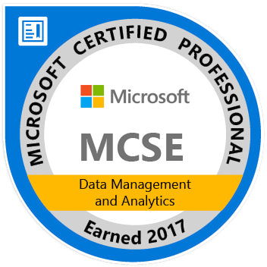
About the speaker
Senior Consultant / DBA – Straight Path Solutions www.straightpathsql.com
>15 years as DBA / DB Dev

Slide 4



The Why
SQL Auth, a step back?
How do I manage it all?
See Also: Breaches are expensive

Slide 5
Azure SQL Foundations
Deployment Options
Option | Type | Features vs. on-premises | Connectivity
SQL virtual machines | IaaS | All | Configured like any other VM
SQL databases | PaaS | Most | Azure SQL Firewall
SQL managed instances | PaaS | Almost All | Native VNET, Database Gateway

Slide 6
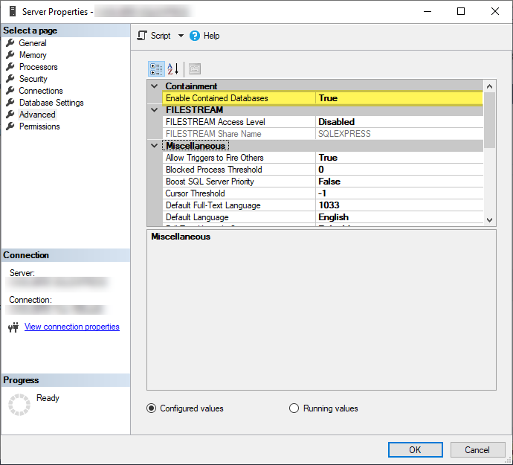
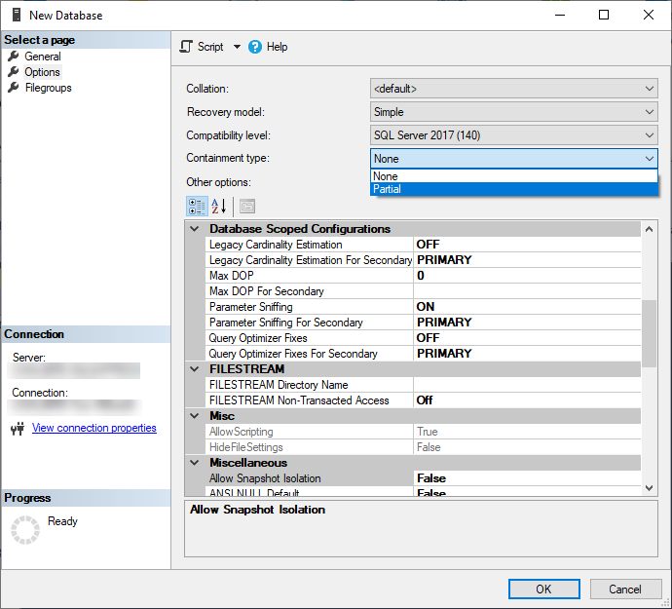
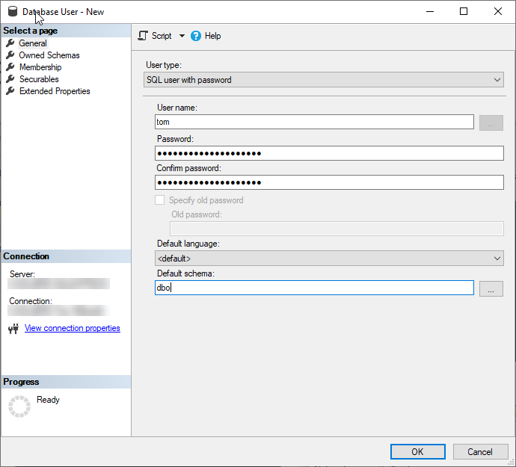
Azure SQL Foundations
Contained Databases

Slide 7
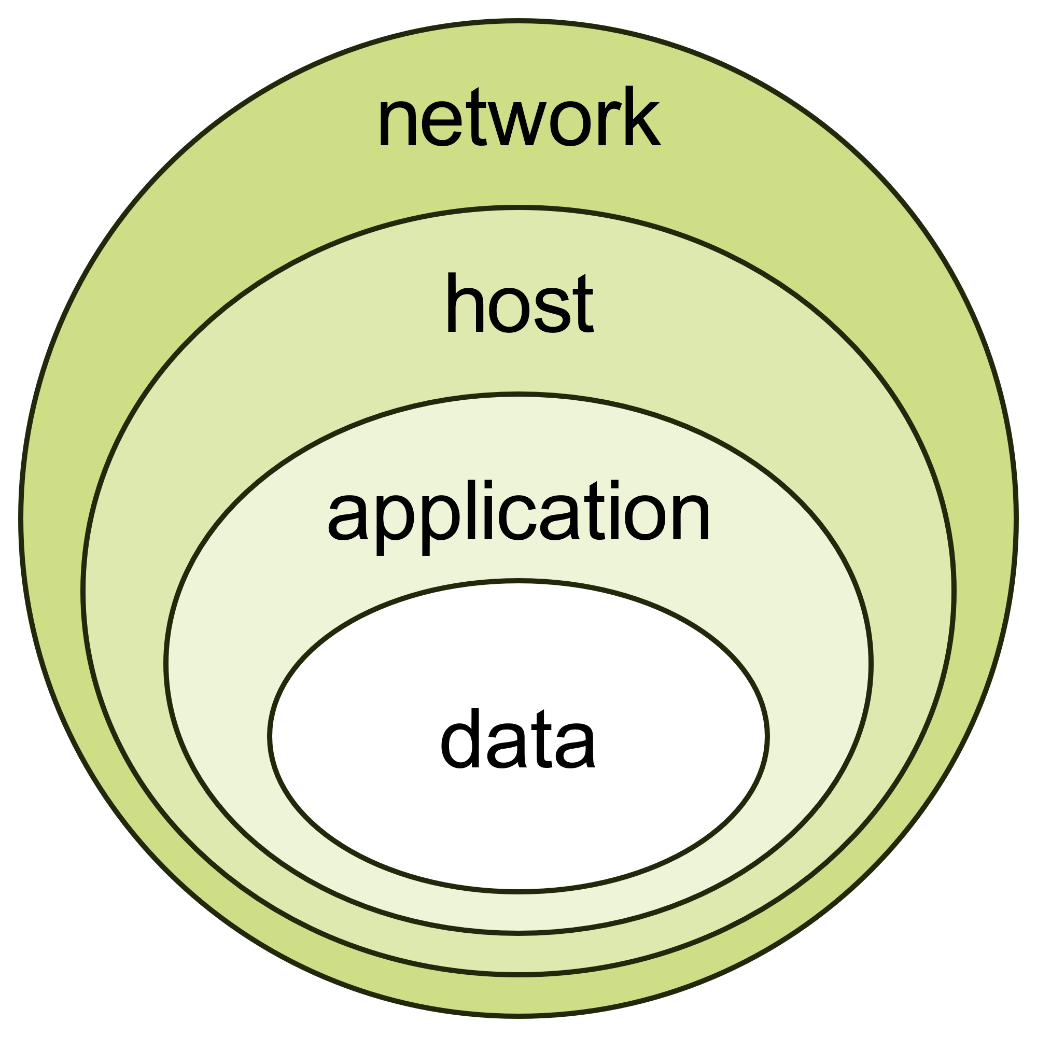
Network Layer
Scope of this presentation
(https://commons.wikimedia.org/wiki/File:Defense_In_Depth_-_Onion_Model.svg),Defense In Depth - Onion Model“, https://creativecommons.org/licenses/by-sa/3.0/legalcode

Slide 8
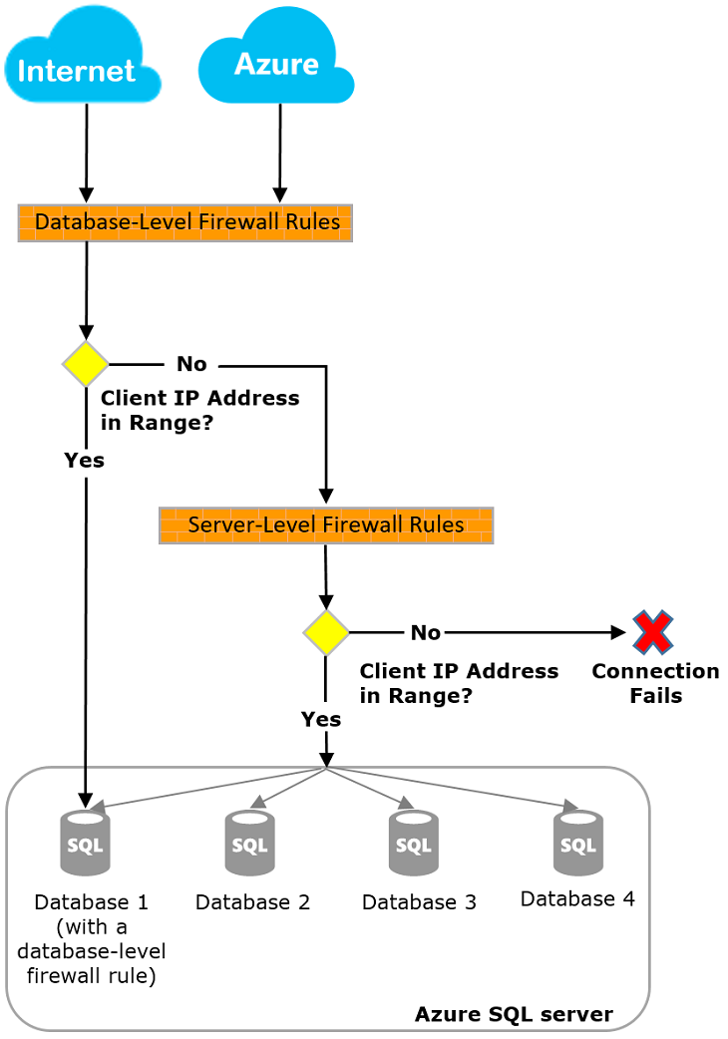
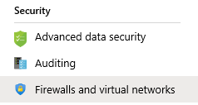
Network Layer
Firewall
Source: https://docs.microsoft.com/en-us/azure/sql-database/sql-database-firewall-configure

Slide 9
Network Layer
Firewall
Database level, T-SQL
Action | Object
Create / Update | sp_set_database_firewall_rule
View | sys.database_firewall_rules
Delete | sp_delete_database_firewall_rule

Slide 10
Network Layer
Firewall
Server level, T-SQL
Action | Object
Create / Update | sp_set_firewall_rule
View | sys.firewall_rules
Delete | sp_delete_firewall_rule

Slide 11
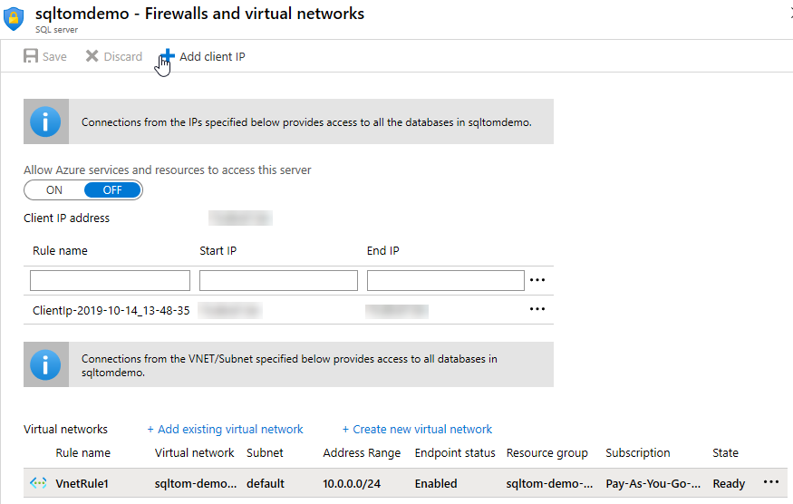
Network Layer
Firewall
Server level, GUI
Allow Azure services
What about VNETs

Slide 12
Demo
Azure SQL Database Firewall

Slide 13
Logins & Users
Logical server / master Roles
Two Unrestricted administrative accounts: Server admin Active Directory admin
Logs into user databases as dbo
Can add/remove members of dbmanager and loginmanager
When using the server-level firewall, can connect to any database

Slide 14
Logins & Users
Logical server / master Roles
dbmanager: allows creation of new databases
Loginmanager: can create new logins in master
ALTER ROLE dbmanager ADD MEMBER …

Slide 15
Logins & Users: Azure Active Directory
Users & Groups
Service Principals
Prerequisite: AD Admin needs to be set at the Logical Server
CREATE USER [tom@sqltom.com] FROM EXTERNAL PROVIDER;
CREATE USER [bob@sqltom.onmicrosoft.com] FROM EXTERNAL PROVIDER;
CREATE USER [MyApplication] FROM EXTERNAL PROVIDER;

Slide 16
Demo
Logins
Users
Roles
Service Principals / Applications

Slide 17
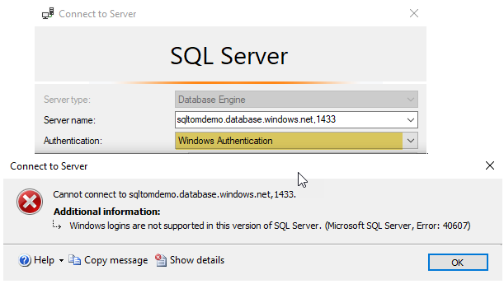
Authentication Options
Windows Authentication
IntegratedSecurity = true

Slide 18
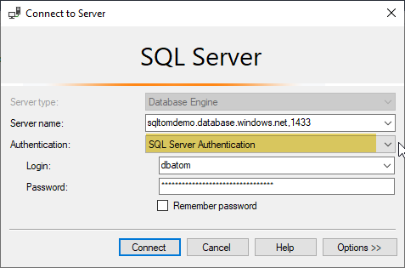
Authentication Options
Windows Authentication
SQL Server Authentication
User ID=username;Password=longpassword;

Slide 19
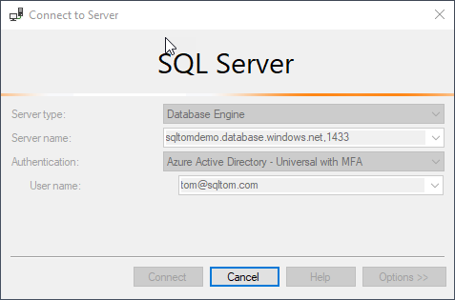
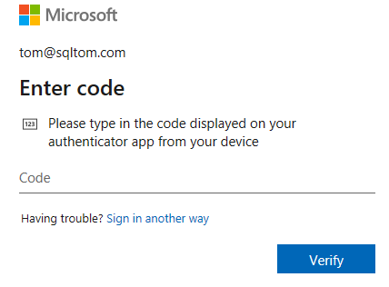
Authentication Options
Windows Authentication
SQL Server Authentication
Azure Active Directory
- Universal with MFA
Authentication="Active Directory Interactive"
SqlConnectionStringBuilder:
SqlAuthenticationMethod.ActiveDirectoryInteractive

Slide 20
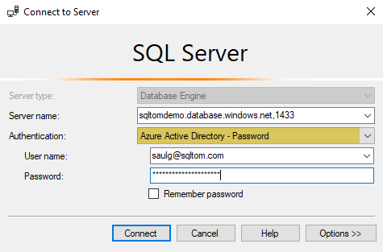
Authentication Options
Windows Authentication
SQL Server Authentication
Azure Active Directory
- Universal with MFA
- Password
Authentication="Active Directory Password"
SqlConnectionStringBuilder:
SqlAuthenticationMethod.ActiveDirectoryPassword

Slide 21
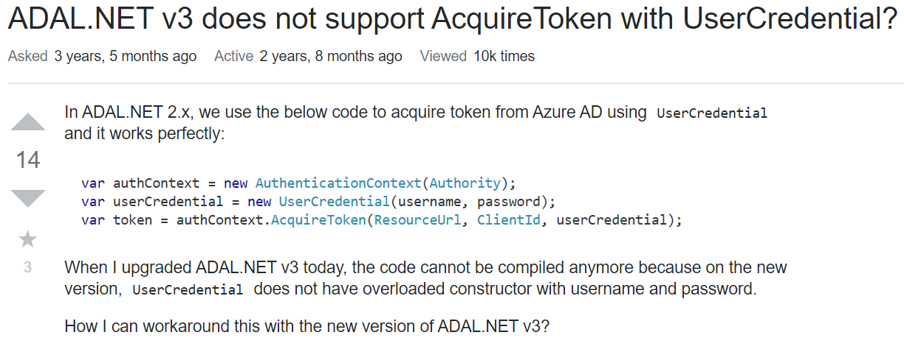
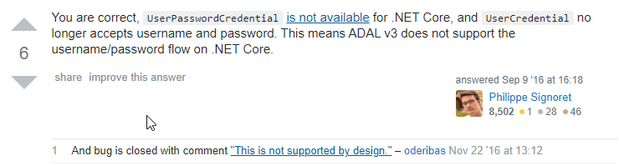
Authentication Options
Windows Authentication
SQL Server Authentication
Azure Active Directory
- Universal with MFA
- Password

Slide 22
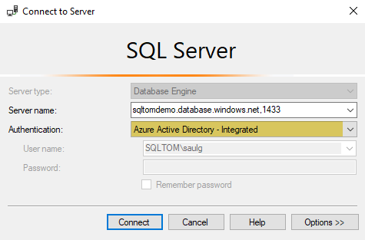
Authentication Options
Windows Authentication
SQL Server Authentication
Azure Active Directory
- Universal with MFA
- Password
- Integrated
Authentication="Active Directory Integrated"
SqlConnectionStringBuilder:
SqlAuthenticationMethod.ActiveDirectoryIntegrated

Slide 23
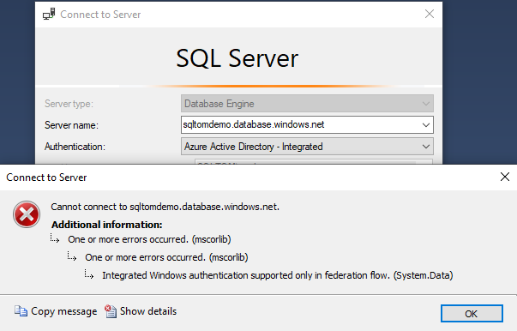
Authentication Options
Windows Authentication
SQL Server Authentication
Azure Active Directory
- Universal with MFA
- Password
- Integrated
Azure AD Connect sync

Slide 24
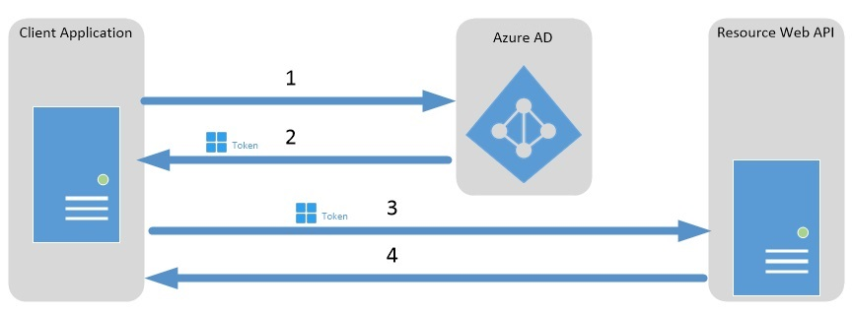
Authentication Options – AAD Tokens
SqlConnection conn = new SqlConnection(ConnectionString); conn.AccessToken = "Your JWT token"

Slide 25
Demo
Authentication options
Visual Studio

Slide 26
Wrap-up
What did we just discuss?
Questions?

Slide 27




Thank You!
@TomWillwerth
linkedin.com/in/TomWillwerth
github.com/tkwj
Tom.Willwerth@straightpathsql.com

Slide 28
Resources / references
https://docs.microsoft.com/en-us/azure/sql-database/sql-database-paas-vs-sql-server-iaas
https://docs.microsoft.com/en-us/azure/sql-database/sql-database-firewall-configure
https://docs.microsoft.com/en-us/dotnet/framework/data/adonet/connection-strings-and-configuration-files
https://www.colinsalmcorner.com/post/configuring-aad-authentication-to-azure-sql-databases
https://docs.microsoft.com/en-us/azure/sql-database/sql-database-aad-authentication-configure#using-an-azure-ad-identity-to-connect-from-a-client-application
https://docs.microsoft.com/en-us/azure/key-vault/quick-create-net

